Slide 1
Sustainable Education Portal along with E-commerce integration
(Internet and Web Programming Project)
Author: Rajdeep Mahanta(22BLC1404) and Anurup Dey(22BLC1406)

Slide 2
Abstract:
(Brief overview)
Our online sustainable bookstore and education portal is dedicated to fostering a culture of eco-consciousness and lifelong learning. By offering a curated selection of environmentally themed books, we empower individuals to explore sustainability topics and drive positive change. Our platform also provides educational resources, interactive courses, and community engagement opportunities, nurturing an informed and proactive audience. Through this initiative, we aim to inspire and equip users with the knowledge and tools to build a sustainable future while supporting ethical publishing and responsible consumption practices.

Slide 3
Introduction:
Welcome to our Sustainable Education Portal, an innovative platform designed to transform the way you engage with learning materials and contribute to environmental sustainability. Our portal offers a comprehensive suite of features tailored to meet the needs of students, educators, and lifelong learners.
At the heart of our platform is a dynamic bookstore where you can purchase a wide range of educational books and materials. To promote sustainability and affordability, we also offer a robust reselling system, allowing you to sell your used books to others in the community. This circular approach not only reduces waste but also makes quality education more accessible.
Complementing our bookstore is a rich repository of educative videos across various subjects and topics. Our video portal is designed to enhance learning through engaging and interactive content, catering to different learning styles and preferences. Join us in our mission to foster an eco-friendly environment while expanding your knowledge and skills.

Slide 4
Existing System
(The list below contains some of the websites, similar to our planned project)
https://www.booksellers.org.uk/bookshopsearch
https://booksellers.springernature.com/
https://www.sustainableschoolshop.com.au/
https://bookstore.teri.res.in/

Slide 5
Methodology:
Frontend Development:
Design and Layout: The "Planetwise" portal was built using HTML for structure and CSS for styling, focusing on a responsive, user-friendly interface. Key features include a sticky navbar, expandable course sections, and a consistent dark blue color scheme.
JavaScript Functionality: JavaScript enhances interactivity, such as expanding course boxes and highlighting the active navbar item.
Content Integration:
YouTube Embedding: Relevant educational videos from reputable channels like TED and National Geographic were embedded using iframes, ensuring users have access to high-quality resources.

Slide 6
E-Commerce Setup:
Shop Page Design: The shop page displays used books related to sustainability in a clean, organized layout with images, descriptions, and an "Add to Cart" feature.
Responsive Design:
Flexbox & Media Queries: Flexbox and media queries ensure the site adapts well to different screen sizes, providing a seamless experience on both desktop and mobile devices.
Challenges and Solutions:
Video Availability: Careful selection of videos from established channels minimizes the risk of content becoming unavailable.
User Experience: Iterative testing and refinement were conducted to optimize the site's usability across various devices.

Slide 7
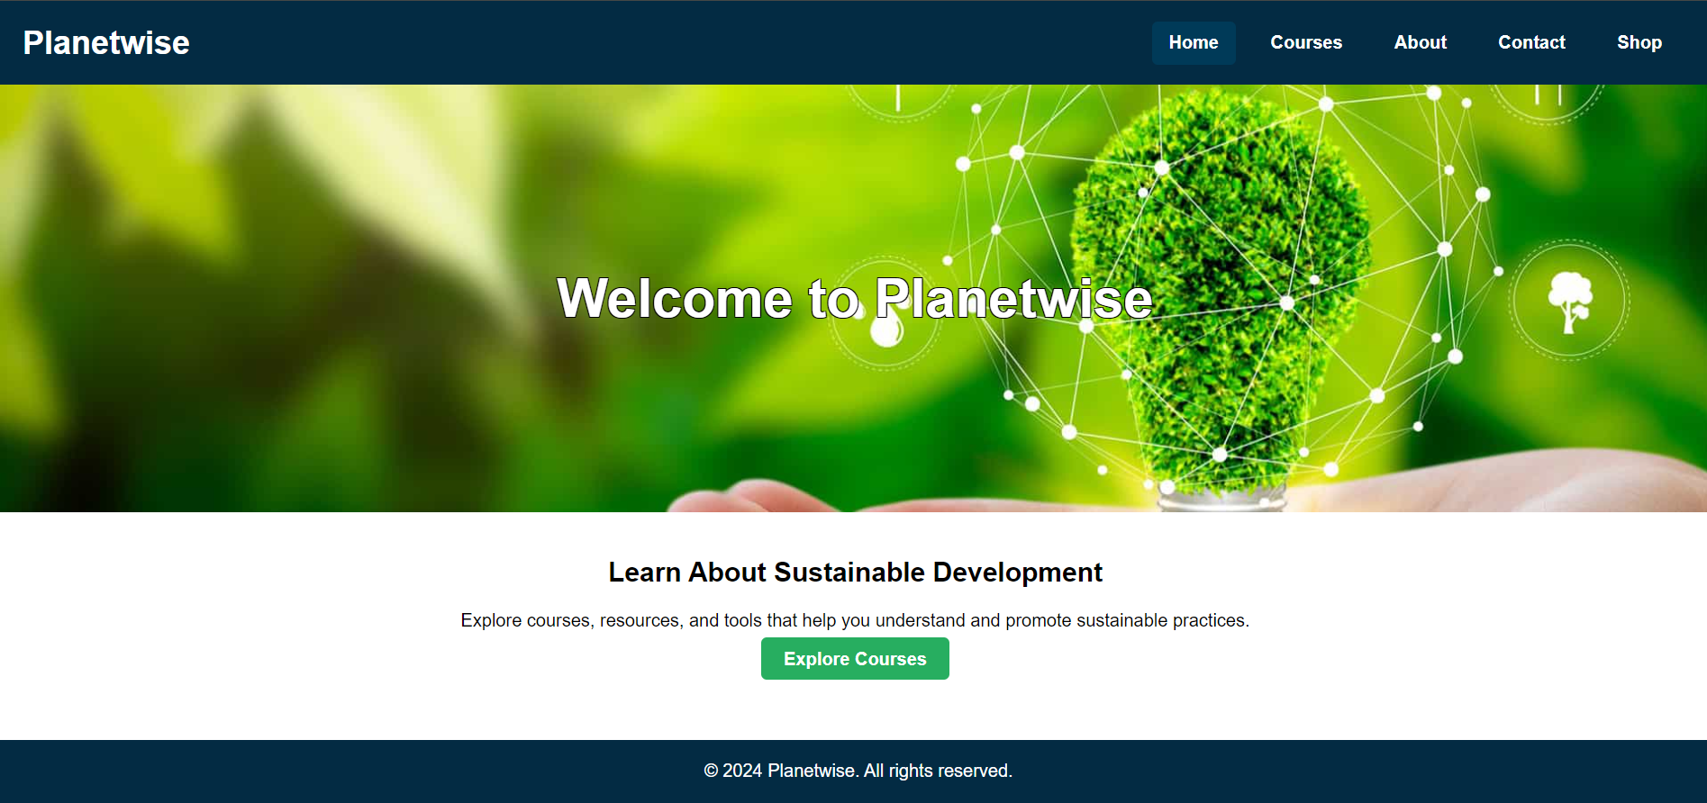
Home

Slide 8
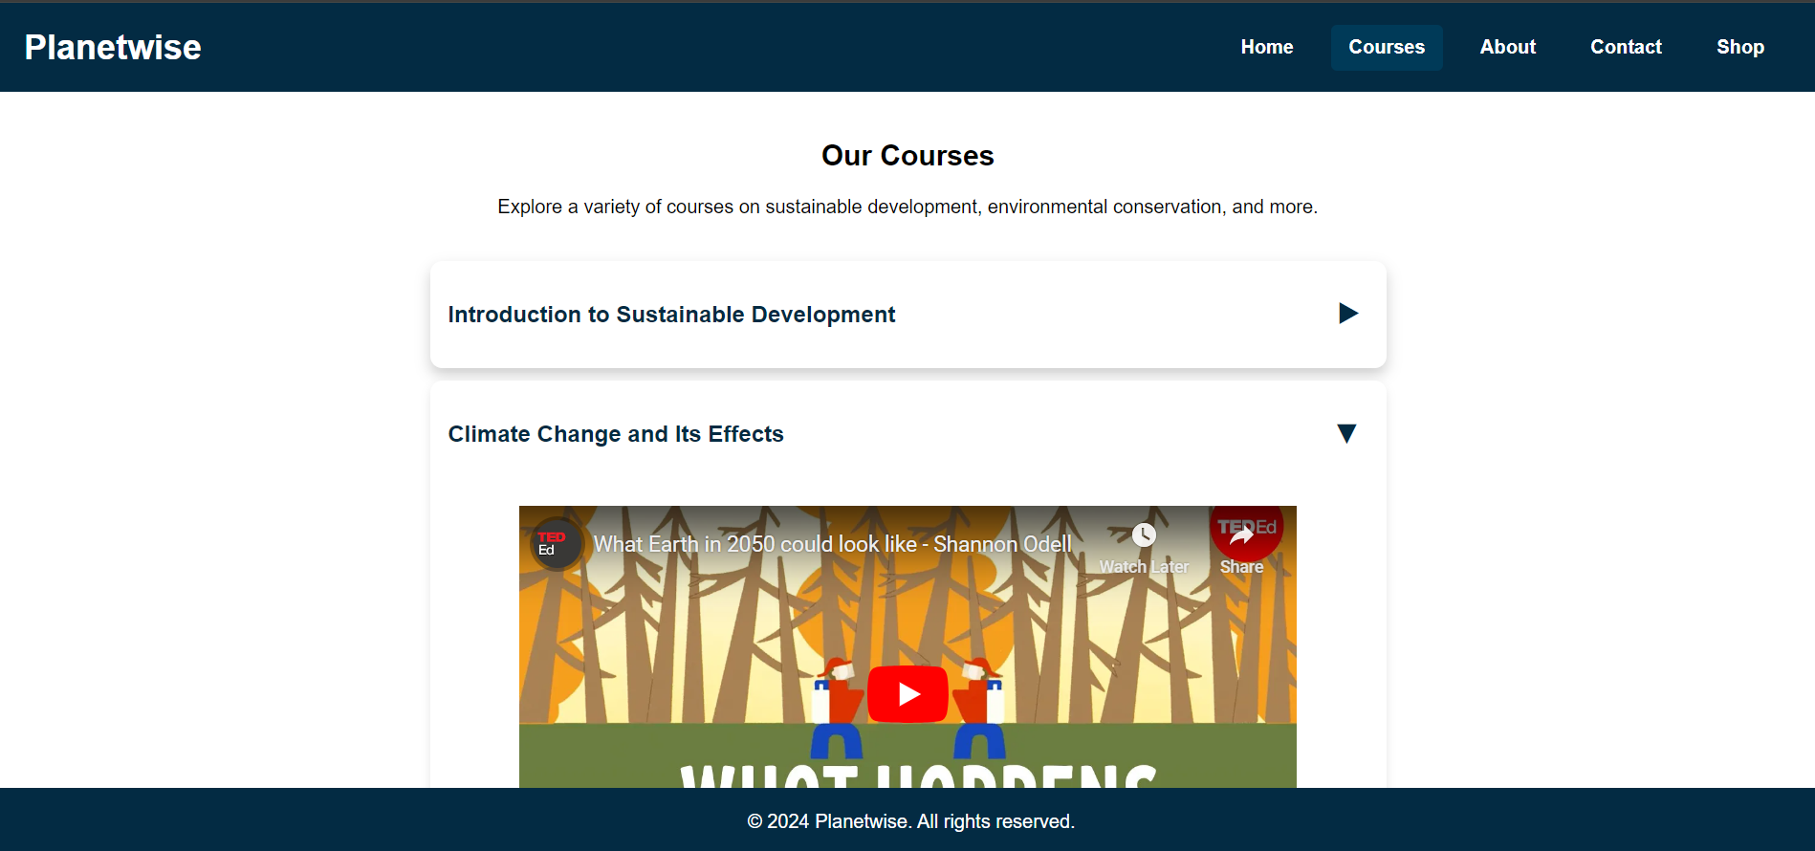
Courses

Slide 9
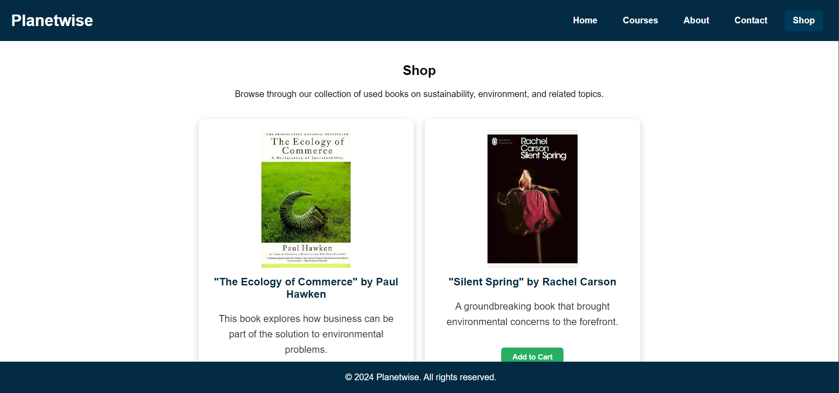
Shop

Slide 10
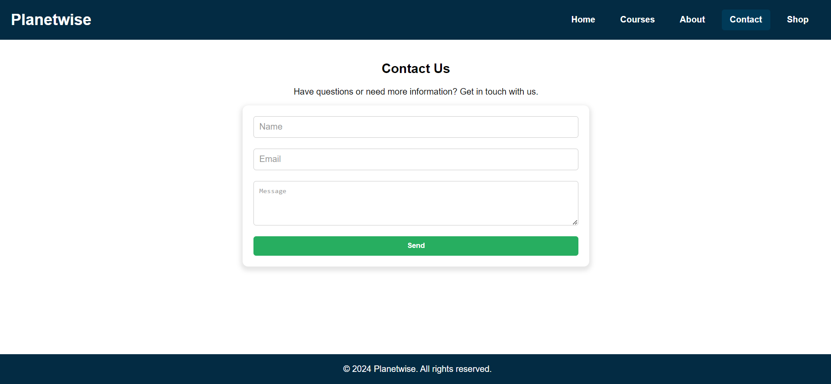
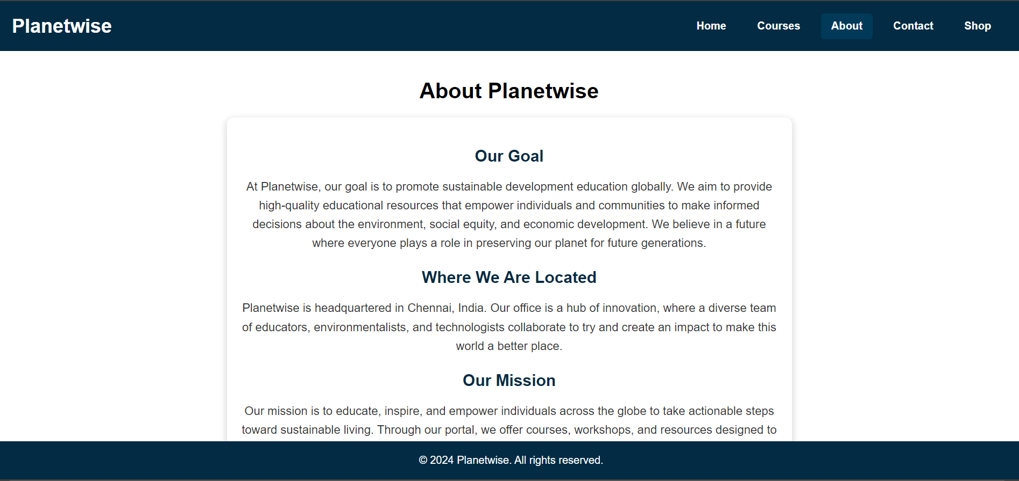
Contact and About

